Slide 1
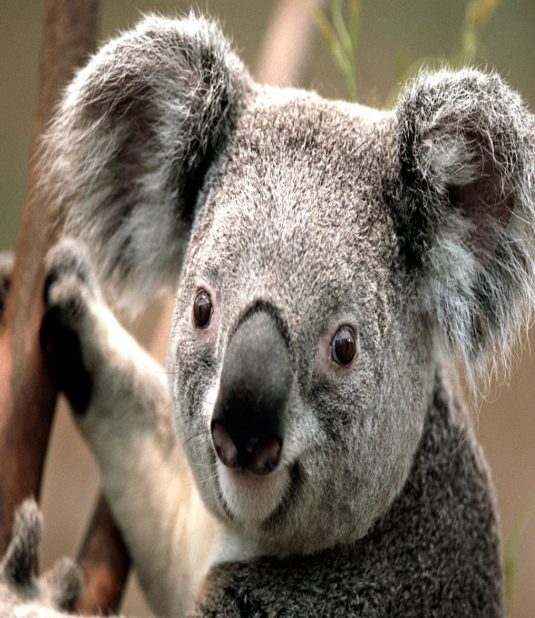
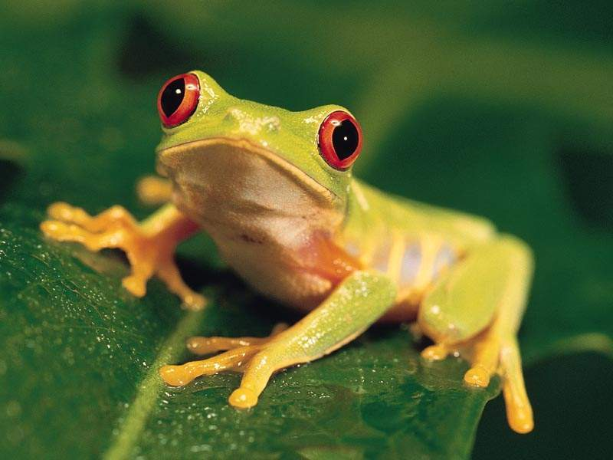
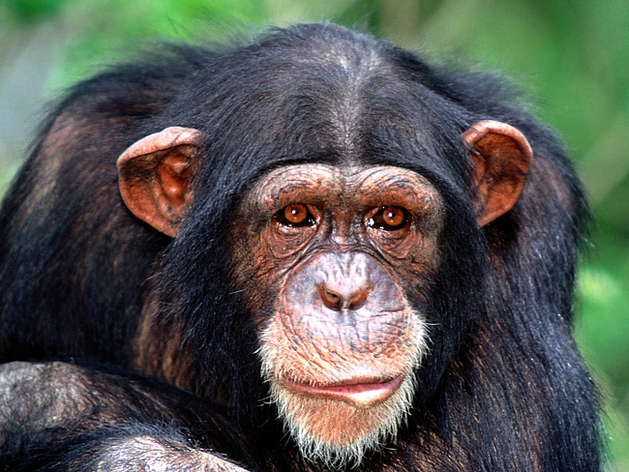
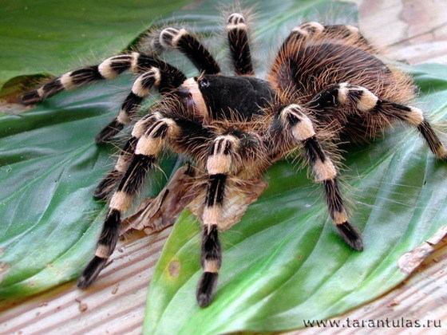
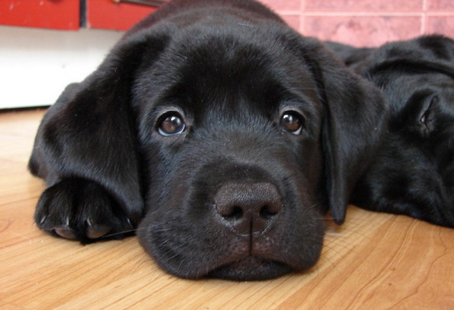
Funny FRIENDS

Slide 2
Guess the creature!
It is the symbol of Australia.
It is one of the main characters of a famous Russian Fairy –tale.
It is ugly and dangerous.
It is very funny.
It is a clever friend of a man.

Slide 3
Make the word- combinations: big, happy, small, green, cute, wonderful, fast, active, lovely, good, smart, funny, calm. A frog

Slide 4
Form the degrees of comparison!
dangerous
big
small
wonderful
good

Slide 5
Make a story using the words and structures: It is….. Big, small, funny, cute, It has…. active, a mouth, eyes, a nose, It can…. arms, legs, jump, climb, swim, It can’t….. It likes ……… fly, run, bananas……

Slide 6
G Guess the animal! It is a insect. It lives in Australia. It is very lazy. It lives in South America. It can climb the trees. a koala It is very dangerous. It eats leaves. It likes a hot weather. a spider

Slide 7
Answer the questions! Is it a pet or a wild animal? Is it big or small? What colour is it? What is it doing? Is it happy or sad? a dog

Slide 8
Fill in the gaps. My pet dog.
This …. my pet dog! ….. name is Benjy. He ….. brown. He ….. got a big body and ….. long tail. His ears …… long, too. He`s got big white ….. and brown eyes. Benjy ……. swim and jump, but he …… climb a tree.

