Slide 1
My Family
(appearance and character)

Slide 2
Let’s repeat the rules of reading

Slide 3
Let’s repeat some grammar rules

Slide 4
My Family

Slide 5
My relatives

Slide 6
Test yourselves

Slide 8
Tell us about your family

Slide 9
Let’s repeat some grammar rules

Slide 13
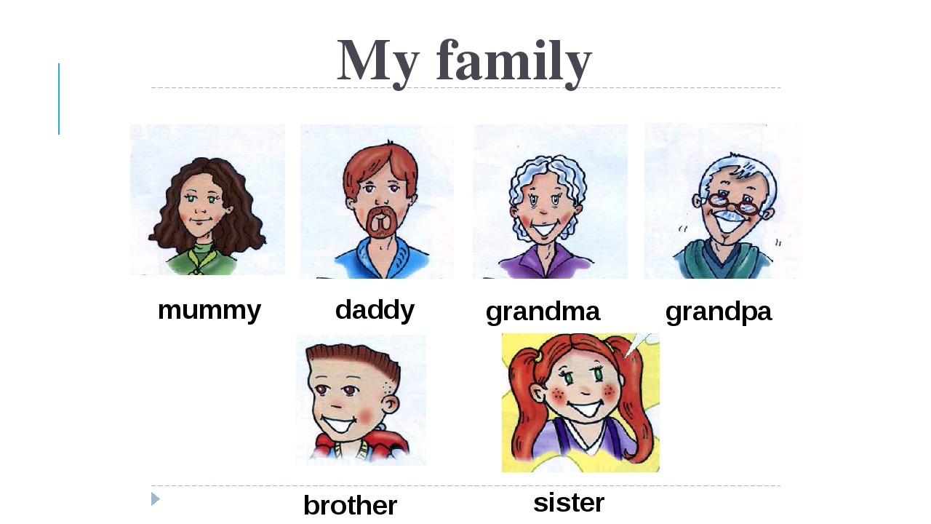
Describe your relative
My mum
My dad
My sister
My brother
My aunt
My uncle
My grandmother
My grandfather (young, old, a teenager, middle-aged)

Slide 14
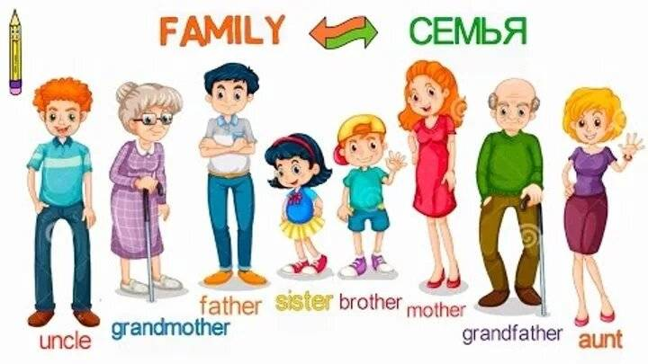
Describe the appearance of your relative
His/ Her (nose, mouth, eyes, hair)
He/ She (tall, short)

Slide 16
What does your ( mother, father, sister, brother) look like? Describe their appearance

Slide 18
Let’s repeat the words once again!

Slide 19
The qualities of character

Slide 20
What is he/ she like? Describe the character of your relative.

Slide 22
Read the stories about a family.

Slide 23
Read some stories about a family

Slide 27
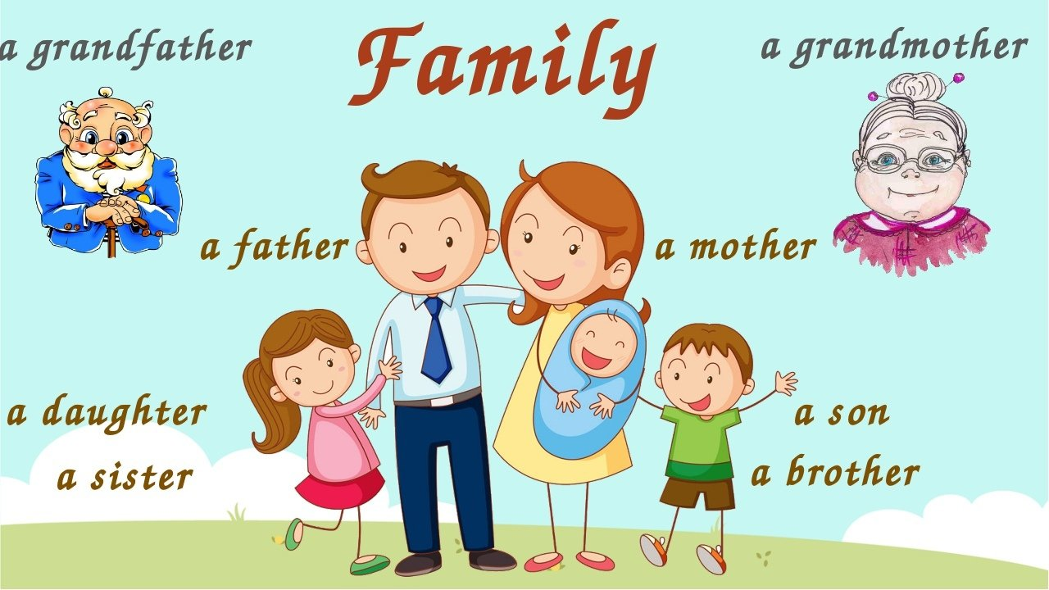
I love my family

